Slide 1
Siren A toolbox to generate adversarial examples and evaluate defense methods for ASRs
Xiaowei Chen
Baidu Security
05/07/2020
Notes:
Siren. Greek mythology. Siren, in Greek mythology, a creature half bird and half woman who lured sailors to destruction by the sweetness of her song.

Slide 2
Motivations: How powerful are the attack methods?
Attack on Wake-word Detection System
Attack
De-activation
Hey, Siri
Music
Paper: Li, Juncheng, et al. "Adversarial Music: Real World Audio Adversary Against Wake-word Detection System." NIPS’19.
Demo: https://www.junchengbillyli.com/AdversarialMusic/

Slide 3
Motivations: How powerful are the attack methods?
Attack on Speech Recognition: Add small (crafted) perturbation to original speech to let the ASR makes mistakes
Crafted perturbation
Wrong transcription
Normal Speech
Carlini, Nicholas, and David Wagner. "Audio adversarial examples: Targeted attacks on speech-to-text." 2018 IEEE Security and Privacy Workshops (SPW). IEEE, 2018.
Qin, Yao, et al. "Imperceptible, robust, and targeted adversarial examples for automatic speech recognition.” ICML’19

Slide 4
Attack Goal: Implement different attack methods to evaluate their damage on real-world ASRs
Notes:
Is the attack really harmful?

Slide 5
Motivations: Are proposed defense methods robust?
Protect Wake-word Detection System
Attack
Still activate
Hey, Siri
Try to de-activate
Music
Defense methods

Slide 6
Defense Goal: Implement different defense methods and evaluate their robustness under different attacks
Notes:
Is the defense really useful?

Slide 7
Toolbox Overview

Slide 8
Overview of our toolbox: Supported Tasks
Model
Speech to Text (STT) via DNN-based ASR Models
Evaluate the robustness of ASR models under different input transformation methods
Attacks
Generate adversarial audio examples with state-of-the-art attack methods
Generate robust and transferable adversarial audio examples
Defenses
Evaluate the robustness of different input transformation-based defense methods

Slide 9

Overview of our toolbox: Framework Design
Augmentation
ASR Services
None
DeepSpeech
Inputs
Predictions
Resample
$$⋯$$
hey google
he google
Hey gogle
……
Quantization
$$⋯$$
Jasper
➕
Filter
Noise
……
……
Accumulated gradients
Attack

Slide 10
Supported ASRs
ASR | Framework | White-box | Supported | Repo Link | CKPT | Datasets | WER
DeepSpeechTF | Tensorflow | yes | yes | Link | DeepSpeech 0.6.1 DeepSpeech 0.5.1 | LibriSpeech Clean | - 7.5% - 8.22%
DeepSpeechPT | PyTorch | yes | yes | Link | AN4 Librispeech TED | - AN4 - Librispeech - TEDLIUM | - 10.349% - 6.654% (clean), 19.889%(other) - 30.886%
Jasper | PyTorch | yes | yes | Link | Jasper10x5dr Jasper10x5dr Jasper10x5SEP QuartzNet15x5 QuartzNet15x5 | - Librispeech - Librispeech, Mozilla, Common Voice, WSJ, Fisher, Switchboard - Aishell2 - Librispeech, Mozilla, Common Voice - Aishell2 | - 3.61% - 3.46%(dev-clean), 10.40%(dev-other), 3.69%(test-clean), 10.49%(test-other) -N/A - 4.19%(test-clean), 10.98%(test-other) -N/A
Wav2letter++ | C++ | no | Not yet | Link
Pykaldi | Python | no | Not yet | Link

Slide 11
Supported Augmentation Methods
Time domain augmentation
Add random noise
Filter
Quantization
Random Crop and Insert
Resampling
Spec domain augmentation
Add random noise
Frequency masking (TODO)
Time masking (TODO)
Time warp (TODO)
Characterizing Audio Adversarial Examples Using Temporal Dependency
Quantization, Local Smoothing, Down sampling, Autoencoder
Robust Audio Adversarial Examples for a Physical Attack
Band-pass Filter (1kHz – 4kHz), Impulse Response (Convolution with reverberations generated in real environment), White Gaussian Noise
SpecAugment: A Simple Data Augmentation Method for Automatic Speech Recognition
Time Warp, Frequency Masking, Time Masking

Slide 12
Supported Attacks
Carlini, Nicholas, and David Wagner. "Audio adversarial examples: Targeted attacks on speech-to-text." SPW’18.
Qin, Yao, et al. "Imperceptible, robust, and targeted adversarial examples for automatic speech recognition.” ICML’19
Supported Criteria
TargetSequence
SimilarSequence
Supported Distances
Mean Square Error (MSE)
Mean Absolute Error (MAE)
L Infinity (Linf)
L0
Masking Threshold Distance (MTD)

Slide 13
Contributions of our toolbox
The first advbox for DNN-based ASRs
To compute the gradients of the loss w.r.t. the inputs, we rewrite the feature extraction of the ASRs and make them differentiable
We support multiple machine learning frameworks
How: wrap ASR models as web service on docker
Do not need to worry about package conflicts between different ASRs
We are the first toolbox to have this design
We are able to generate “robust” adversarial examples
Adversarial examples pass different augmentation methods and transfer to different ASRs (play-over-the-air and transferability)
We are able to evaluate the ”robustness” of defense methods
Evaluate the defense methods via “adaptive attack”
Tramer, Florian, Nicholas Carlini, Wieland Brendel, and Aleksander Madry. "On adaptive attacks to adversarial example defenses." arXiv:2002.08347

Slide 14
Demos
We also provide command line interface to perform the following tasks
Speech to text for audio files
Generate Adversarial Examples (AE)
Naïve AEs
Transferable + Robust AEs

Slide 15
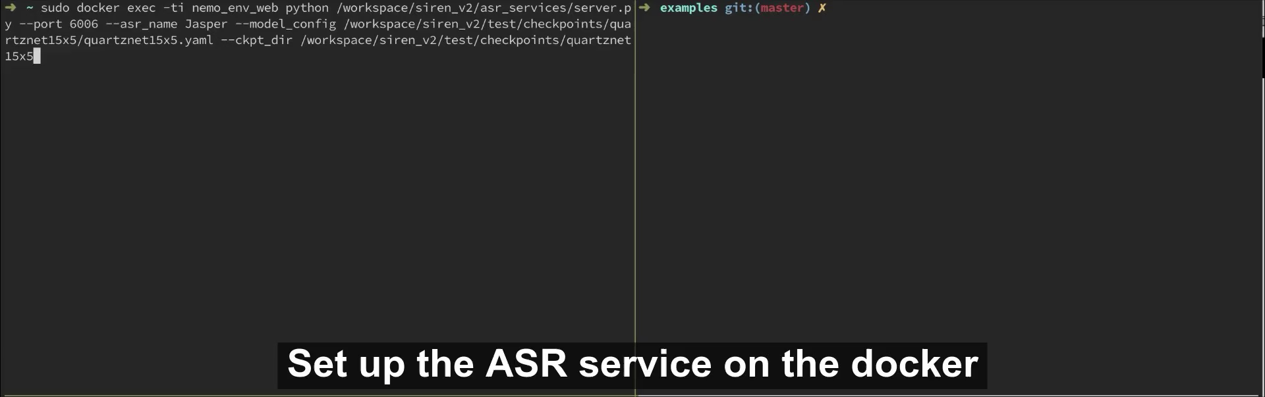
Speech-to-Text via curl

Slide 16
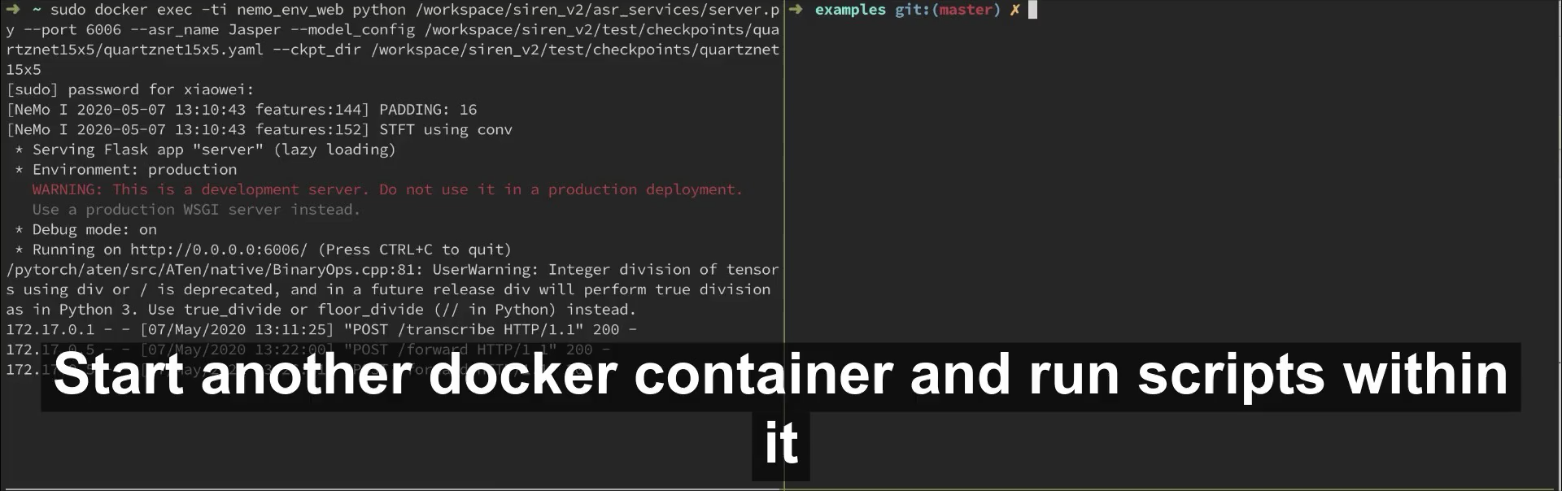
Speech-to-Text query in another docker

Slide 17
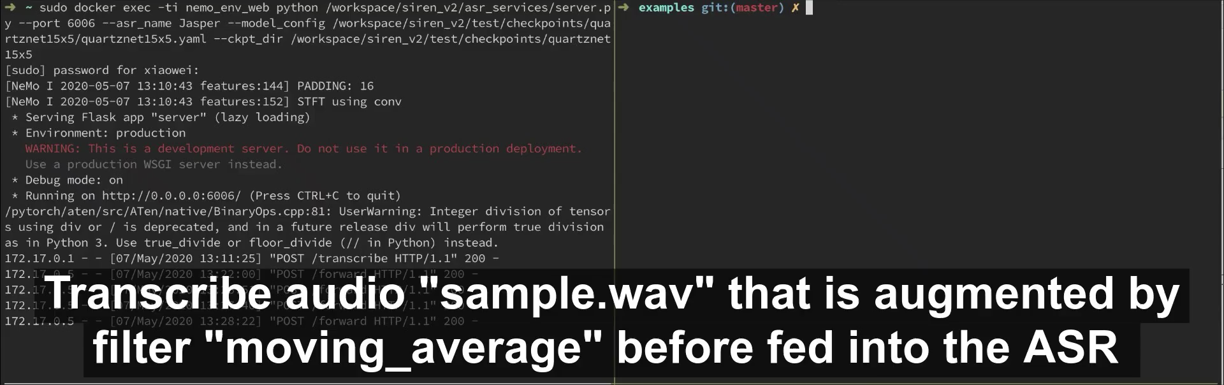
Speech-to-Text with different augmentation methods

Slide 18
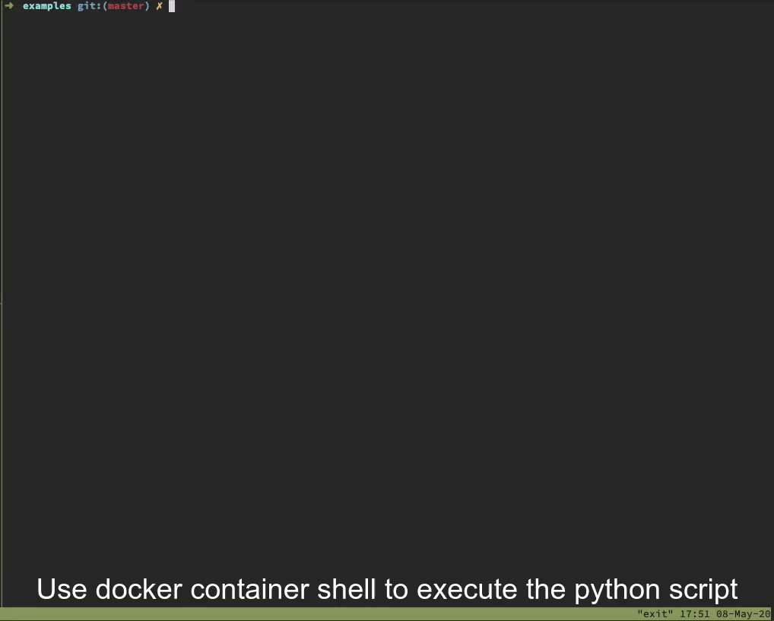
Generate Adversarial Examples

Slide 19
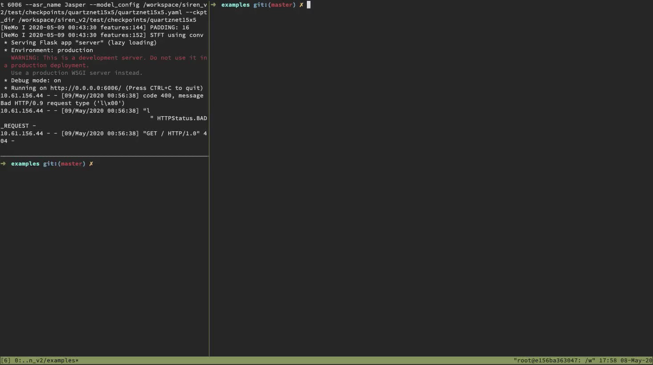
Generate Robust and Transferable Adversarial Examples

Slide 20
Our relationship with Baidu AdvBox
Siren A toolbox to generate adversarial examples and evaluate defense methods for ASRs
We are here

Slide 21
Who can use our toolbox
Researchers
Develop more attack, defense algorithms
Engineers
Evaluate the attack, and defense methods
……
How to have an open-source project
Packaging the toolbox
Human-readable Document

Slide 22
TODO List
Easy
Add Speech Command Recognition model in NVIDIA Nemo to our framework
Re-implement part of the data augmentation methods with pytorch
Medium
Add more ASR models to our toolbox (i.e., DeepSpeech Paddle, Wav2letter++, pykaldi)
Enable model tuning for the ASR models

